Slide 1
Machine Learning Project
Loan Predictor Model

Slide 2
Roadblocks
Started with Emotion Recognition Model
Planned to deploy on Google Cloud
Took very long time to train
Ran into runtime issues with Google Colab and library installation issues on Google Cloud

Slide 3
Loan Dataset and Limitations
Limited size of model training dataset
There were a sizeable amount of null values which had to be removed before training the model, so we lost some sample data points

Slide 4
Models and Accuracy
Logistic Regression: ~80%
Random Forest: ~70%
Decision Tree: ~80%

Slide 5
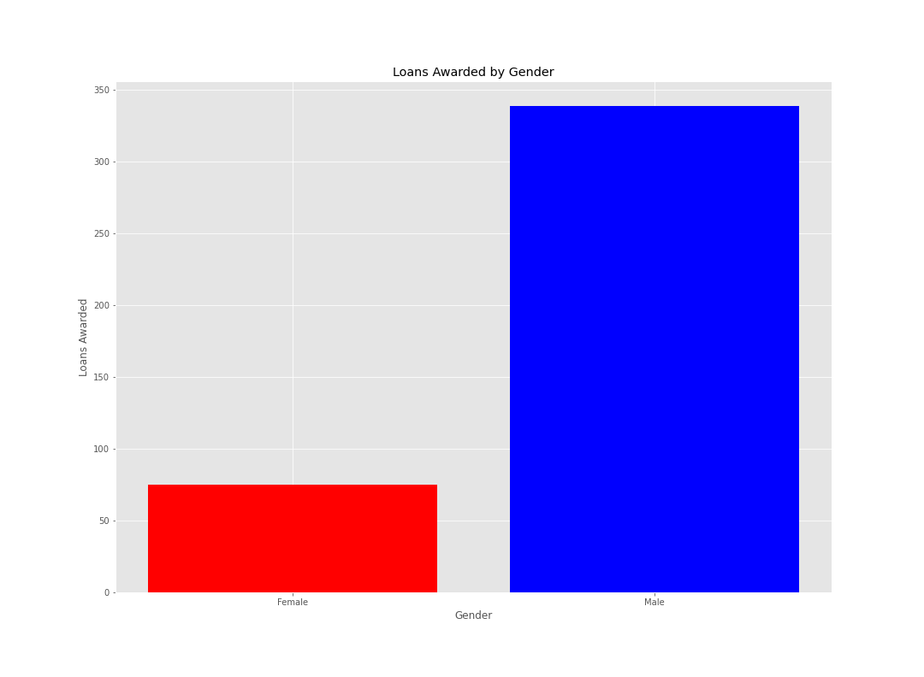
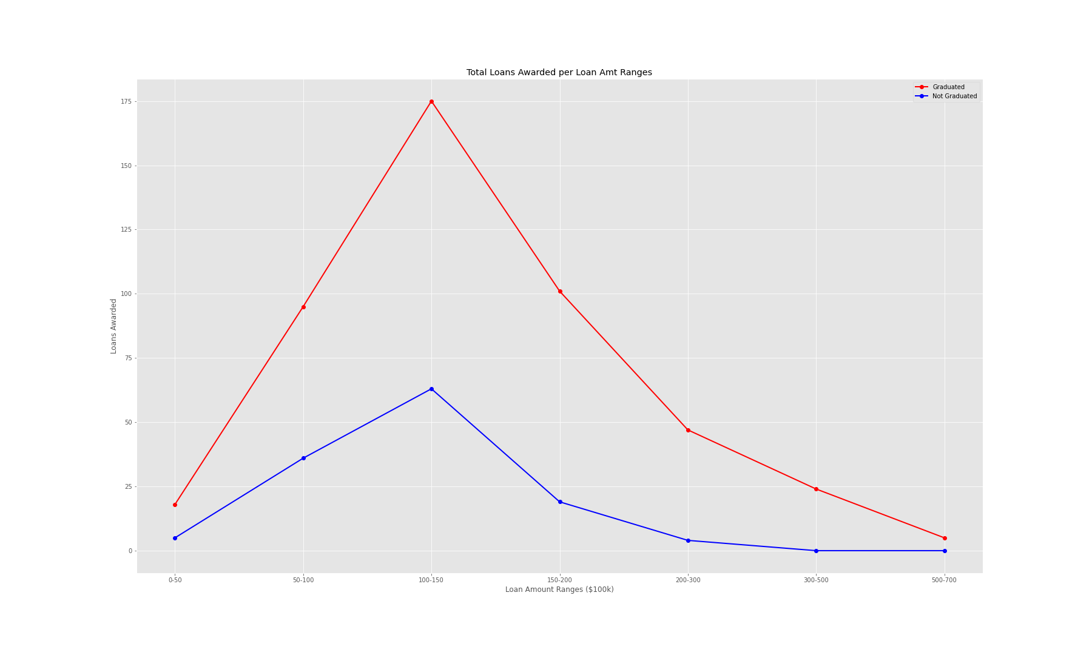
Loans Awarded by Gender and Graduation Status

Slide 6
Further Exploration
Explore additional independent variables
Integrate geographic locations to the dataset
Further explore the types of loans being given (i.e., risky business venture, cars, property, etc.)

